Slide 1
LPDDR6 DFI Kickoff
Kerollos Aweida
Moamen Hussein

Slide 2
Agenda
LPDDR6 DFI interface.
Frequency Ratios (Cmd ratio , Data ratio)
Main features
DBI inversion
Even Cycle command only
Read data rotation
Low power control

Slide 3
LPDDR6 DFI interface

Slide 4
LPDDR6 DFI interface.
dfi_sc0_cs_p_N
LPDDR6_dfi_phy
Command interface SC0
dfi_sc0_address_p_N
Write Data interface SC0
dfi_sc0_wrdata_p_N
dfi_sc0_wrdata_en_p_N
lpddr6_dfi_ctrl_sc0
dfi_sc0_rddata_en_p_N
CK0-CA0-CS0
LPDDR6 Softmodel
Read Data interface SC0
dfi_sc0_rddata_valid_w_N
LPDDR6 Sub_channel 0
dfi_sc0_rddata_w_N
dfi_sc0_cmd_freq_ratio
lpddr6_dfi_data_sc0
dfi_sc0_data_freq_ratio
DQ0-RDQS0
Status interface SC0
dfi_freq_ratio
dfi_sc0_init_start
dfi_sc0_init_complete
dfi_sc0_lp_ctrl_req
lpddr6_dfi_error_sc0
Low power interface SC0
dfi_sc0_lp_ctrl_wakeup
dfi_sc0_lp_ctrl_ack
dfi_sc0_clk
dfi_sc0_phy_clk
clocking SC0
dfi_sc0_wck
Command interface SC1
dfi_sc1_cs_p_N
dfi_sc1_address_p_N
lpddr6_dfi_ctrl_sc1
LPDDR6 Sub_channel 1
dfi_sc1_wrdata_p_N
CK1-CA1-CS1
Write Data interface SC1
dfi_sc1_wrdata_en_p_N
dfi_sc1_rddata_en_p_N
Read Data interface SC1
dfi_sc1_rddata_valid_w_N
lpddr6_dfi_data_sc1
dfi_sc0_rddata_w_N
DQ1-RDQS1
dfi_sc1_cmd_freq_ratio
dfi_sc1_data_freq_ratio
Status interface SC1
dfi_freq_ratio
dfi_sc1_init_start
lpddr6_dfi_error_sc1
dfi_sc1_init_complete
dfi_sc1_lp_ctrl_req
Low power interface SC1
dfi_sc1_lp_ctrl_wakeup
dfi_sc1_lp_ctrl_ack
dfi_sc1_clk
dfi_sc1_phy_clk
clocking SC1
dfi_sc1_wck

Slide 5
Frequency Ratios (Cmd freq ratio , Data freq ratio)

Slide 6
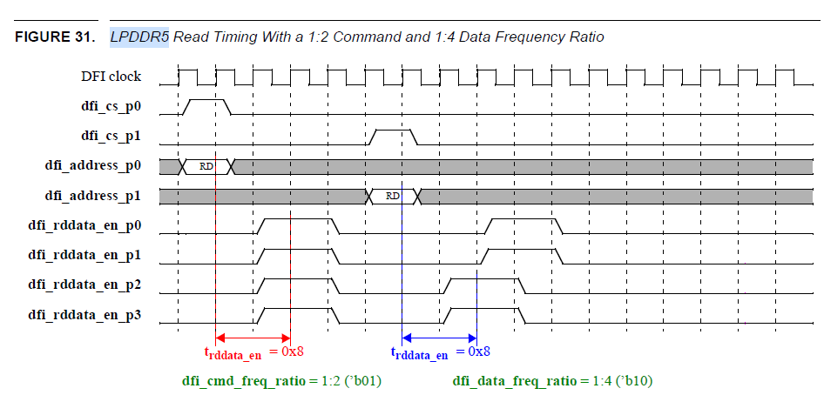
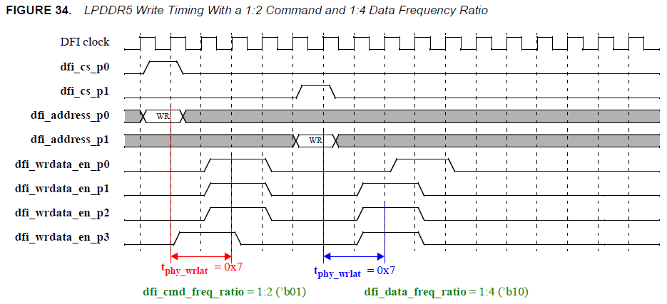
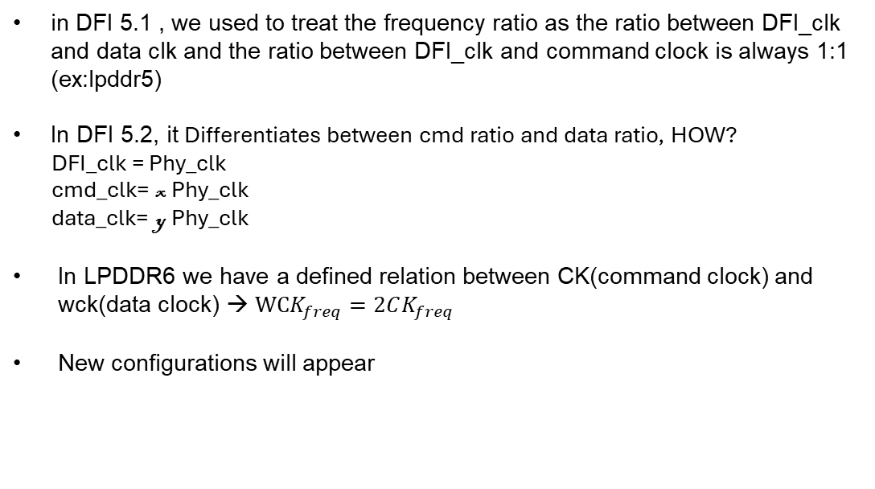
Frequency Ratios (Cmd freq ratio , Data freq ratio)
in DFI 5.1 , we used to treat the frequency ratio as the ratio between DFI_clk and data clk and the ratio between DFI_clk and command clock is always 1:1 (ex:lpddr5)
In DFI 5.2, it Differentiates between cmd ratio and data ratio, HOW?
DFI_clk = Phy_clk
cmd_clk= x Phy_clk
data_clk= y Phy_clk
In LPDDR6 we have a defined relation between CK(command clock) and wck(data clock) → $WCK_{freq}=2CK_{freq}$
New configurations will appear
 | Cmd Ratio | Data Ratio
Original configurations | 1:1 | 1:2
New valid configurations | 1:2 | 1:4
 | 1:4 | 1:8

Slide 7
Frequency Ratios (Cmd freq ratio , Data freq ratio)
lpddr5_dfi_data
dfi_clk
dfi_read_mcs
dfi_phy_clk
dfi_sc0_rddata_w_N
DQ
Old models had only one ratio (Data ratio)
In LPDDR5
dfi_CLK is treated as CK .
dfi_phy_clk and lpddr5_wck are the same.
Common code models generates data according to this concept that dfi_phy_clk=lpddr5_wck , so data is generated with dfi_phy_clk rate
In LPDDR6 case
dfi_CLK is used to sample the data from the MC.
dfi_phy_clk is treated as a ratio from dfi_CLK so it would be CK
lpddr6_wck is treated as double the ratio of dfi_CLK
If we used the same concept as all models write mcs will generate data in half the data rate needed for the model
Same for read mcs but in sampling the data from the model
Proposal:
Use lpddr6_wck inside write/read mcs model to delay data in wck rate
Requirement:
lpddr6_wck should be free running
dfi_clk
dfi_write_mcs
dfi_phy_clk
DQ
dfi_sc0_wrdata_p_N

Slide 8
Frequency Ratios (Cmd freq ratio , Data freq ratio)
In order to support two independent ratios and 1:8 frequency ratio configuration, the following common modules will be impacted
dfi_read_mcs
dfi_write_mcs
dfi_ctrl_dly
dfi5_clk_gen
dfi_alrt_rprt
So, our proposal is do the same as DDR5 , implement new version of these modules for LPDDR6 specifically , and update dfi_generics consequently

Slide 9
DBI Inversion

Slide 10
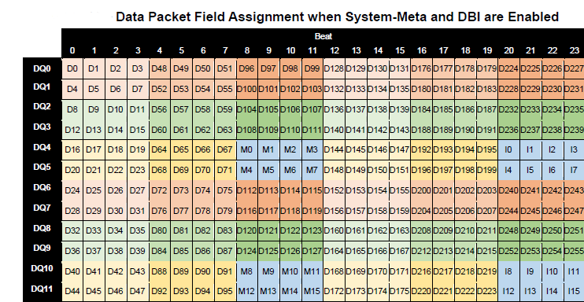
DBI Inversion
As discussed before LPDDR6 has the inversion bits within the data packet
We won’t have neither dfi_wrdata_mask nor dfi_rddata_dbi signals on the interface
Phy_dbi_mode will be considered as parameter
Case1: Phy_dbi_mode = 0 , the controller will handle the dbi inversion
The Read/Write data will be by passed by the phy to the MC/softmodel
Case2 :Phy_dbi_mode=1 , the phy should handle the inversion
Phy_dbi_mode will be bypassed to the model to turn-off the dbi feature inside the LP6 , so the phy can bypass the read and write data without any processing.

Slide 11
Even Cycle command only

Slide 12
Even Cycle command only
This Feature emphasizes the importance of receiving command in Even cycles only , after doing CK sync sequence.
This feature is enabled in LPDDR6 through a parameter EVEN_CYCLE_CMD_ONLY.
I suggest that the DFI sets this parameter to zero to enable the user to send commands any time without the headache of syncing and defining even and odd cycles.

Slide 13
Read data rotation

Slide 14

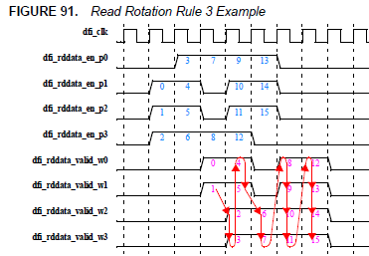
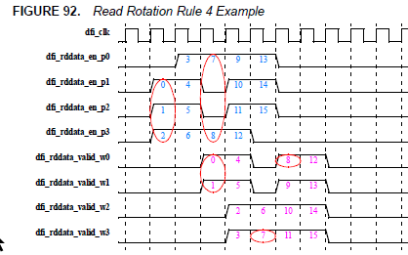
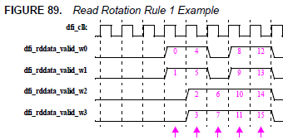
Read Data Rotation Rules
DFI 5.2 formulated rules for data rotation for large frequency ratio systems 1:4 and 1:8

Slide 15
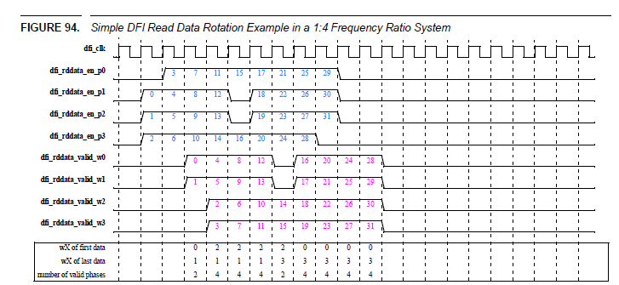
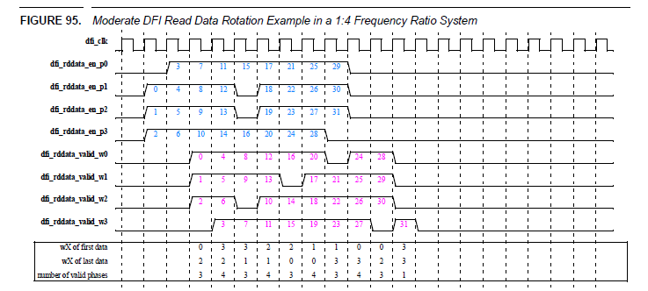
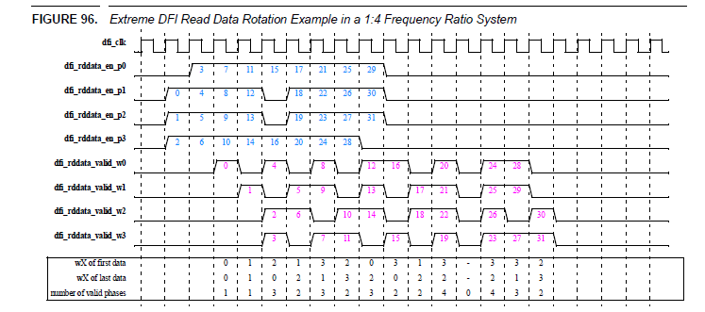
Read Data Rotation: Simple, Moderate, and Extreme
Our DFI softmodels, so far, follow simple read data rotation with RDLAT_MODE=0 with no gaps during burst beats on read DFI.
For RDLAT_MODE =1 , we also don’t have gaps but we start on the phase based on the t_phy_rdlat.

Slide 16
LPDDR6 DFI UVM Environment

Slide 17
UVM Unified Environment

Slide 18
LPDDR6 DFI Architecture
uvm_test
RTL_top
dfi_seqs
LPDDR6 seqs
uvm_env
Agent #channel
Driver BFM #channel
LPDDR6 config
mem-driver base code
DFI
Sequencer
txn
config
LP6-DFI _driver
LP6-DFI
Dfi SB&
Monitor&Translate DFI interface
Coverage
txn
Monitor BFM #channel
Mem-IF txn
LP6 SB (#channel)
txn
LPDDR6-DFI _monitor
LPDDR6 _monitor
Notes:
LP6-DFI _driver hands to Driver BFM not from ??? Hands
LP6 config was moved to be inside agent, as each config per SC’s agent

Slide 19
LPDDR6 DFI UVM environment notes
The DFI driver will extend the mem base driver overwriting the main cmd/data driving functions (similar to the device driver )
The DFI Monitor will be written to translate the DFI txn on the DFI interface to a device txn that can be executed by the scoreboard
The monitor will read from the DFI monitor instead of the device interface
The same sequences of LP6 can be reused on the UVM environment in addition to some DFI specific sequences (DFI init, DFI freq change ,….)
The environment will have number of agents equals to number of channels (2 agents in LP6)
During the efficiency mode only one agent will be active (similar to LP6 environment)

Slide 20
Clocking in UVM unified environment
In G7 DFI environment we have dfi_drv_clk (ahead from dfi_clk ) and dfi_mon_clk (delayed from dfi_clk)
In LP6 environment we are using one version of clk on both driver and monitor (driving on the negedge and the monitoring on the next posedge)
By using the same clocking scheme as the LP6 device environment we will have 3 main clock domains
DFI clock
Phy clk – cmd clk
Wck
The dfi_driver and dfi_monitor will be working in the dfi_clk domain
The LP6 monitor will be working on the phy_clk (cmd_clk) domain , a transaction will be sent on every edge on this clock contains a command its data (the data is double the rate of cmd)

Slide 21
Driving in UVM unified environment
The DFI driver has a queue of the command transactions sent by sequences and it uses pop_front function to get the next item
A semaphore will be used to lock / unlock getting the next transaction from the queue (multiple threads can call the function
The driver will send cmd and data phases on the dfi_clk posedge
The command transaction will contain the cmd_type that can be either DFI_cmd or LP6_cmd

Slide 22
Monitoring in UVM unified environment
The DFI monitor will sample the dfi bus on the edge of DFI clock
The DFI monitor send the txn to the device monitor on the edge of the phy_clk (cmd_clk)
The device monitor will sample the transactions sent from the dfi monitor (instead of the device interface in the usual device environment)
The device monitor send the transactions to the mem scoreboard for checking (similar to the usual device environment)
The dfi scoreboard checks for DFI specific functionality (like LP or DFI error)
In G7 the DFI monitor send the transaction on phy_clk and the device monitor samples on phy_clk_ahead (an advance version from the same clock)

Slide 23
Development Phases
Phase 1
Split command and frequency ratios in common code.
Add 1:8 data frequency ratio .
Support update interface (Frequency ratios update)
Control Commands (No data commands).
Read operation with all frequencies (RD_LAT=0 , Read data rotation) .
Write operation with all frequencies.
Phase 2
Dram clock (CK) disable and enable .
RD_LAT =1 , No Read data rotation
Low power interface.
Alert support .

Slide 24
Thanks

